Slide 1
DSCI 6007-Final Project YouTube Data Analysis Pipeline with AWS Services
Team Members:
Sudheer Kumar tatavalu
Anji Reddy sattaru
Sridhar Jurapala
Date: April 22, 2024
Notes:
For Educators: You can use this template to help your students effectively present and communicate their project to a broader audience. Your students can also use this presentation as a portfolio of their work to demonstrate their cloud skills.
The presentation structure is listed below. The total time may vary depending on the activity you want to conduct. For example, you may want your students to provide high-level walkthrough of their final solutions versus deep-dive into why or how they chose certain services and the steps of building their architectures.
Suggested timing for a 15-minute presentation:
Introduction – 30 seconds
Business scenario overview – 1 minute
Solution overview – 5 minutes
Architecture diagram of the solution – 2 minutes
Demo – 5 minutes
Lessons learned – 1.5 minutes

Slide 2
Introduction:
Importance of YouTube Trends: YouTube's immense popularity makes it a vital platform for content creators and marketers alike. Understanding trends here can unlock significant opportunities for audience engagement and brand growth.
Objective: Our project aims to delve into YouTube trends to provide actionable insights for navigating the digital landscape effectively.

Slide 3
Business scenario overview
Need for Data Analysis Pipeline: With the sheer volume of data on YouTube, manual analysis is impractical. A structured pipeline is essential for efficiently extracting valuable insights.
Challenges: Manual analysis is time-consuming and prone to errors. Additionally, disparate data sources and formats can lead to data silos, hindering comprehensive analysis.
Notes:
Define the problem or opportunity that you are addressing. Include pictures, figures, and statistics to help the audience better conceptualize the problem or opportunity.
Specify who your users or customers are and what pain points they are experiencing.
For example: “Users complain that the student admissions department website is too slow and isn’t always available.”
Also, list any specific business requirements that you are addressing.
For example: “Improve the experience for users. The web application can be deployed to the AWS Cloud. The application must be highly available, scalable, load balanced, secure, and performant architecture that can support thousands of users.“
Note:
An above-bar overview succinctly defines the problem and opportunity statement. For example: “Customers with media files, such as retail companies, need an easy and cost-effective way to analyze photos and videos of their inventory.”
A below-bar overview is too verbose, technical, or not specific. For example: “The most common media files are .jpg and .mp4. Companies have media files of their inventory.”

Slide 4
Solution overview
AWS Services: Leveraging AWS services such as S3 for storage, Glue for ETL (Extract, Transform, Load) processing, Lambda for serverless compute, Athena for querying data, and QuickSight for visualization creates a robust and scalable solution.
Workflow: The integration of these services forms a cohesive pipeline, enabling seamless data flow from ingestion to visualization.
Notes:
Explain at a high level what you have built.
For example: “I built a web application for a company to host their blog.“
Talk about why you chose certain parts of the solutions and any tradeoffs that you made. Focus on how you designed the solutions and how you applied the AWS Well-Architected Framework as part of the process (AWS Well-Architected Framework: https://docs.aws.amazon.com/wellarchitected/latest/framework/welcome.html).
For example: “I configured load balancers and auto scaling to make the application highly available and reliable.”
Include the use cases that you are addressing. Think about who your users are and how they would want to interact with your solution to solve their problem.
For example: “Users can view, upload, edit, and delete blog posts. Administrators can approve blog posts.”
Talk about the use cases that you addressed as part of the minimum viable product (MVP) that you scoped and built.
Note:
An above-bar description is concise and includes the most important benefits. For example: “The solution allows customers to quickly upload, store, and search large catalogs of images and videos in Amazon S3.”
A below-bar description is too detailed or not specific. For example: “Our solution analyzes media files.”

Slide 5
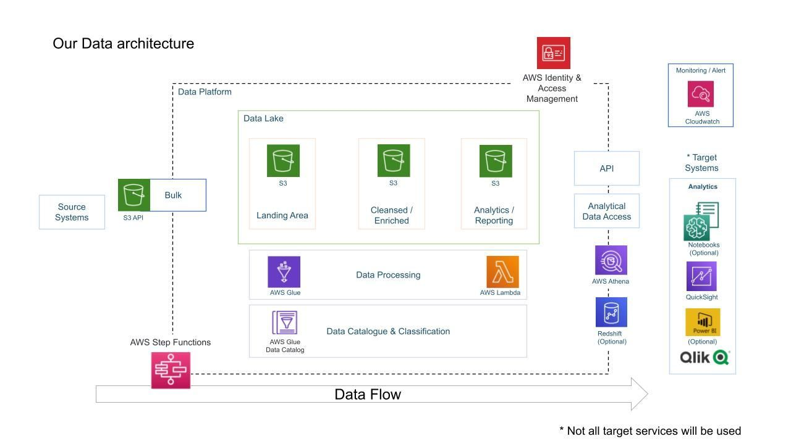
Architecture diagram of the solution
Notes:
Use the following resources to create a diagram of your application architecture:
AWS Architecture Icons at https://aws.amazon.com/architecture/icons. This page includes diagram assets as well as links to drawing and diagramming tools that you can use.
As you walk through the architecture, make sure that you relate back to the business requirements and the AWS Well-Architected Framework (https://docs.aws.amazon.com/wellarchitected/latest/framework/welcome.html).
You can also go more in depth about the design considerations and trade-offs that you made.

Slide 6
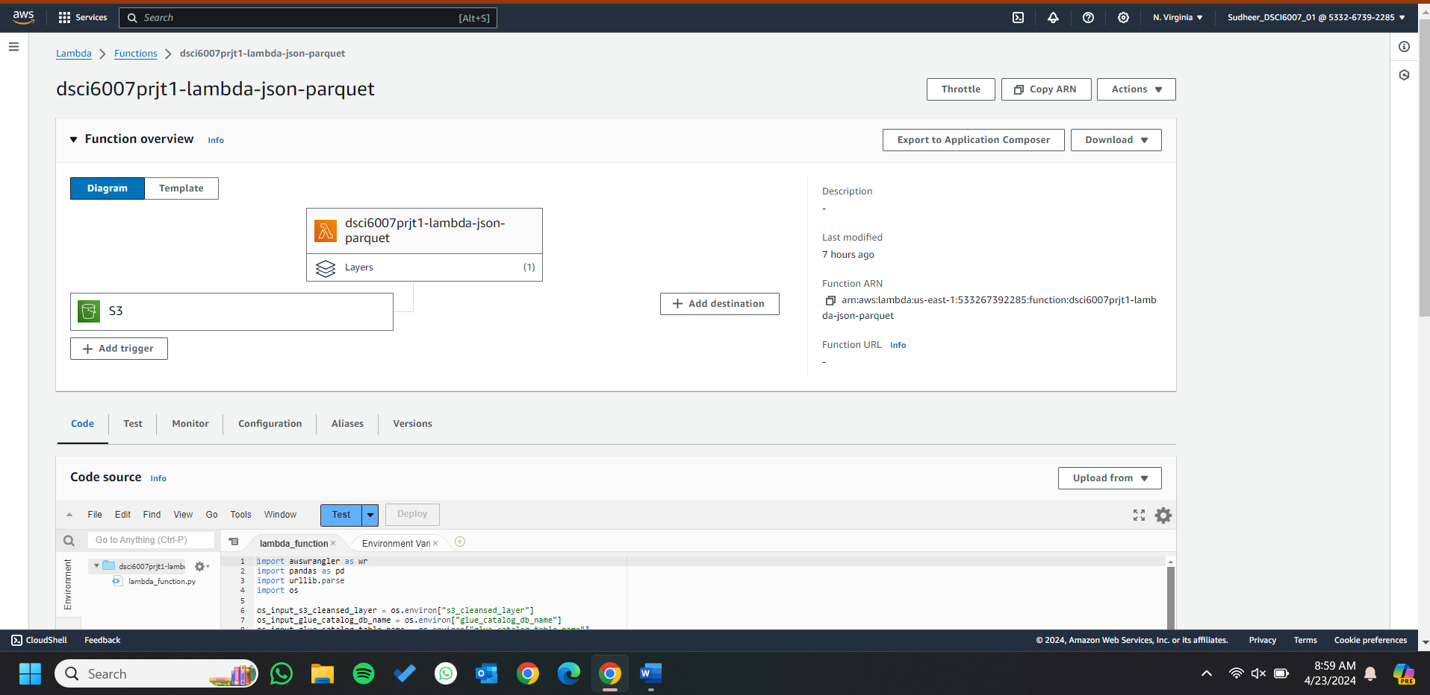
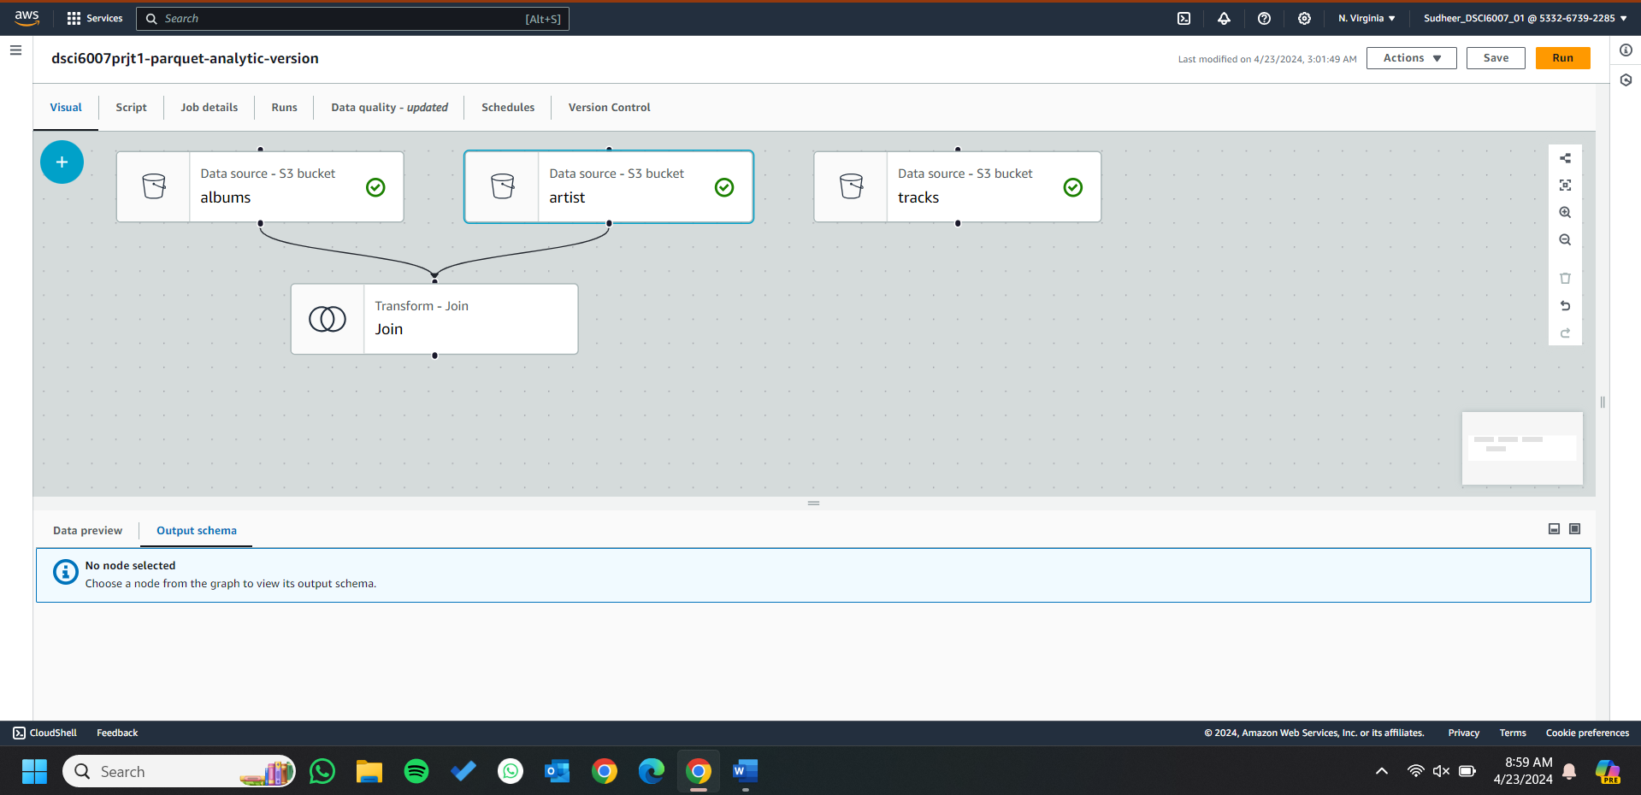
AWS jobs ScreenShots:
Aws Lambda job:
Aws Glue Job:

Slide 7
Data Engineering Pipeline:
Ingestion: Python scripts or Kaggle datasets fetch data, which is then stored in the scalable S3 storage.
Storage: S3 acts as a central repository for both raw and processed data, ensuring accessibility and durability.
Processing: Glue ETL jobs transform and clean the data, while Lambda functions automate tasks, ensuring efficient processing and real-time capabilities.
Consumption: Athena enables querying and analysis of data stored in S3, empowering stakeholders with actionable insights.

Slide 8
Model Deployment:
Serverless Deployment: Utilizing AWS Lambda and Glue for model deployment ensures scalability and cost-efficiency. With serverless architecture, resources are provisioned dynamically, minimizing overhead costs and maximizing flexibility.

Slide 9
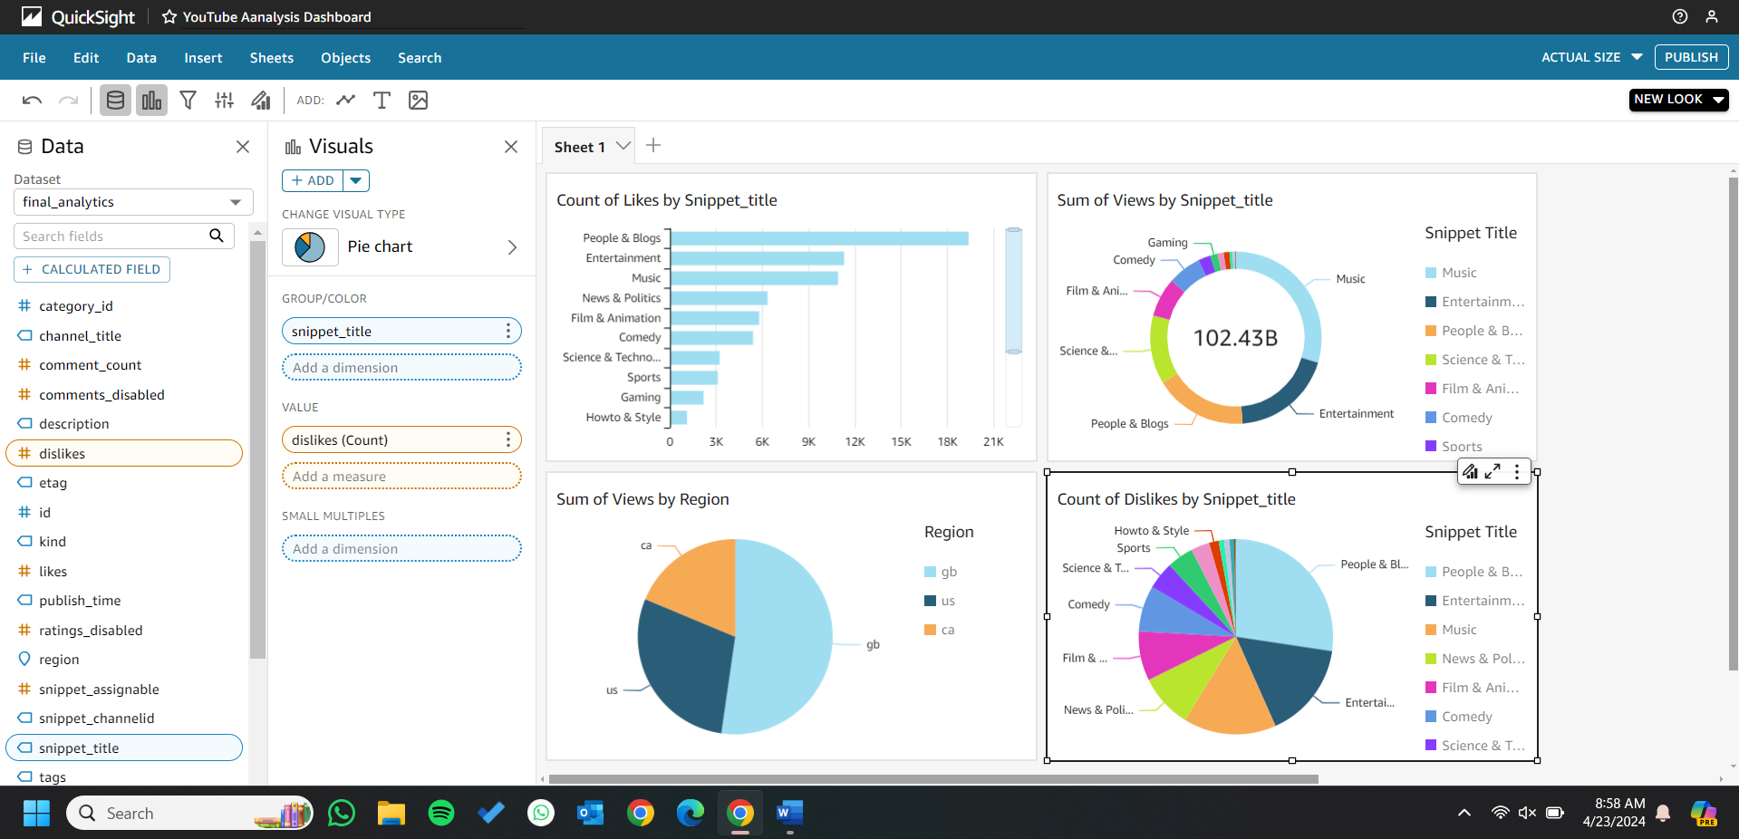
Data Visualization:
Insights: Visualizations provide insights into trends, preferences, and patterns within the YouTube data, aiding decision-making processes for content creators and marketers.

Slide 10
Lessons learned
Challenges Overcame:
Successfully navigated integration complexities, optimized performance, and ensured data accuracy to overcome key challenges in our data analysis pipeline.
Resources Found Helpful:
Leveraged AWS documentation, online communities, and training courses to gain valuable insights and support in implementing our data analysis solution effectively.
New Skills Utilized:
Developed proficiency in AWS services and data engineering concepts, enhancing our problem-solving abilities and fostering continuous skill development.
Next Steps:
Committing to continuous improvement, skill enhancement, and collaboration to further refine our data analysis capabilities and drive future success.
Notes:
Describe any challenges that you encountered and how you overcame those challenges.
For example: “I got stuck when I was creating an EC2 instance to host the application. I used the resources that were listed in the instructions to walk myself through the process to create a new EC2, and I was able to complete the task. The links to labs in other courses were very helpful.”
Describe any new skills that you learned from this project.
For example: “I learned how to set up auto scaling correctly so my resources were automatically adjusted and allocated at the lowest possible cost.”
Discuss any future, out-of-scope use cases in the next steps.
For example: “I would like to scale out the web application so that multiple departments can use it.”

Slide 11
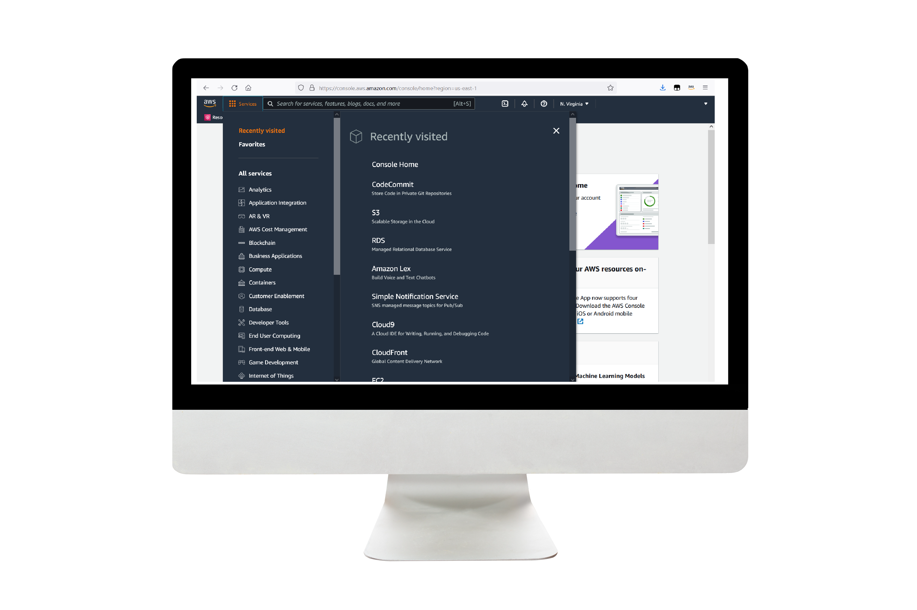
Demo
Link to the demo materials.
Notes:
For the demo, guide the audience through the two to three most important benefits of the solution and how it addresses the requirements.
Your demo materials can be screen captures, recordings, a link to your final solution, and/or a link to AWS console.

Slide 12
Thank you

